Slide 1
Asumsi
Gambar berukuran 7x5
Window berukuran 3x3
Dengan demikian:
Line buffer berukuran 7x2
Window buffer berukuran 6x3

Slide 2
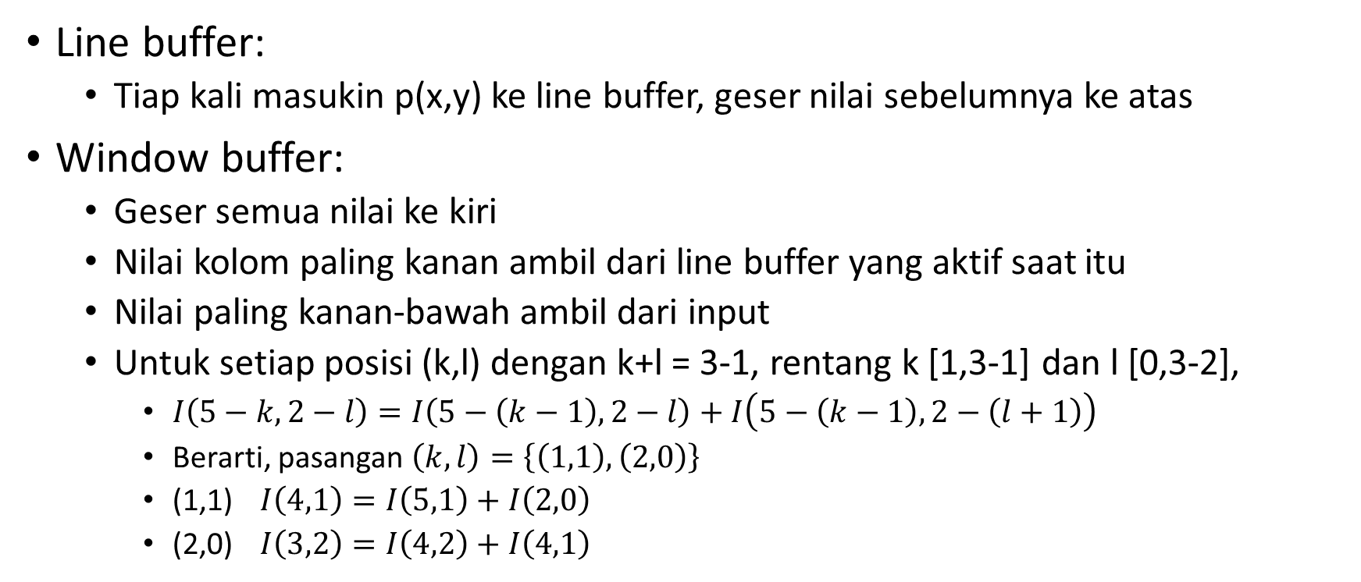
Aturan
Line buffer:
Tiap kali masukin p(x,y) ke line buffer, geser nilai sebelumnya ke atas
Window buffer:
Geser semua nilai ke kiri
Nilai kolom paling kanan ambil dari line buffer yang aktif saat itu
Nilai paling kanan-bawah ambil dari input
Untuk setiap posisi (k,l) dengan k+l = 3-1, rentang k [1,3-1] dan l [0,3-2],
$I\left(5−k,2−l\right)=I\left(5−\left(k−1\right),2−l\right)+I\left(5−\left(k−1\right),2−\left(l+1\right)\right)$
Berarti, pasangan $\left(k,l\right)=\left\{\left(1,1\right),\left(2,0\right)\right\}$
(1,1) $I\left(4,1\right)=I\left(5,1\right)+I\left(2,0\right)$
(2,0) $I\left(3,2\right)=I\left(4,2\right)+I\left(4,1\right)$

Slide 3

Aturan (2)
Integral buffer:
Untuk rentang u dan v [0,2], $II\left(u,v\right)=II\left(u,v\right)+I\left(u+1,v\right)−I\left(0,v\right)$

Slide 4
 |  |  | 0 | 0 | 0 | 0 | 0 | 0 | 0
 | P(0,0) |  | 0 | 0 | 0 | 0 | 0 | 0 | 0
0 | 0 | 0 |  | 0 | 0 | 0 | 0 | 0 | 0
0 | 0 | 0 |  | 0 | 0 | 0 | 0 | 0 | 0
0 | 0 | 0 |  | 0 | 0 | 0 | 0 | 0 | P(0,0)

Slide 5
 |  |  | 0 | 0 | 0 | 0 | 0 | 0 | 0
 | P(1,0) |  | P(0,0) | 0 | 0 | 0 | 0 | 0 | 0
0 | 0 | 0 |  | 0 | 0 | 0 | 0 | 0 | 0
0 | 0 | 0 |  | 0 | 0 | 0 | 0 | 0 | 0
0 | 0 | 0 |  | 0 | 0 | 0 | 0 | P(0,0) | P(1,0)

Slide 6
 |  |  | 0 | 0 | 0 | 0 | 0 | 0 | 0
 | P(2,0) |  | P(0,0) | P(1,0) | 0 | 0 | 0 | 0 | 0
0 | 0 | 0 |  | 0 | 0 | 0 | 0 | 0 | 0
0 | 0 | 0 |  | 0 | 0 | 0 | 0 | 0 | 0
0 | 0 | P(0,0) |  | 0 | 0 | 0 | P(0,0) | P(1,0) | P(2,0)

Slide 7
 |  |  | 0 | 0 | 0 | 0 | 0 | 0 | 0
 | P(3,0) |  | P(0,0) | P(1,0) | P(2,0) | 0 | 0 | 0 | 0
0 | 0 | 0 |  | 0 | 0 | 0 | 0 | 0 | 0
0 | 0 | 0 |  | 0 | 0 | 0 | 0 | 0 | 0
0 | P(0,0) | P(0,0) + P(1,0) |  | 0 | 0 | P(0,0) | P(1,0) | P(2,0) | P(3,0)

Slide 8
 |  |  | 0 | 0 | 0 | 0 | 0 | 0 | 0
 | P(4,0) |  | P(0,0) | P(1,0) | P(2,0) | P(3,0) | 0 | 0 | 0
0 | 0 | 0 |  | 0 | 0 | 0 | 0 | 0 | 0
0 | 0 | 0 |  | 0 | 0 | 0 | 0 | 0 | 0
P(0,0) | P(0,0) + P(1,0) | P(0,0) + P(1,0) + P(2,0) |  | 0 | P(0,0) | P(1,0) | P(2,0) | P(3,0) | P(4,0)

Slide 9
 |  |  | 0 | 0 | 0 | 0 | 0 | 0 | 0
 | P(5,0) |  | P(0,0) | P(1,0) | P(2,0) | P(3,0) | P(4,0) | 0 | 0
0 | 0 | 0 |  | 0 | 0 | 0 | 0 | 0 | 0
0 | 0 | 0 |  | 0 | 0 | 0 | 0 | 0 | 0
P(1,0) | P(1,0) + P(2,0) | P(1,0) + P(2,0) + P(3,0) |  | P(0,0) | P(1,0) | P(2,0) | P(3,0) | P(4,0) | P(5,0)

Slide 10
 |  |  | 0 | 0 | 0 | 0 | 0 | 0 | 0
 | P(6,0) |  | P(0,0) | P(1,0) | P(2,0) | P(3,0) | P(4,0) | P(5,0) | 0
0 | 0 | 0 |  | 0 | 0 | 0 | 0 | 0 | 0
0 | 0 | 0 |  | 0 | 0 | 0 | 0 | 0 | 0
P(2,0) | P(2,0) + P(3,0) | P(2,0) + P(3,0) + P(4,0) |  | P(1,0) | P(2,0) | P(3,0) | P(4,0) | P(5,0) | P(6,0)

Slide 11
 |  |  | 0 | 0 | 0 | 0 | 0 | 0 | 0
 | P(0,1) |  | P(0,0) | P(1,0) | P(2,0) | P(3,0) | P(4,0) | P(5,0) | P(6,0)
0 | 0 | 0 |  | 0 | 0 | 0 | 0 | 0 | 0
0 | 0 | 0 |  | 0 | 0 | 0 | 0 | 0 | P(0,0)
P(3,0) | P(3,0) + P(4,0) | P(3,0) + P(4,0) + P(5,0) |  | P(2,0) | P(3,0) | P(4,0) | P(5,0) | P(6,0) | P(0,1)

Slide 12
 |  |  | P(0,0) | 0 | 0 | 0 | 0 | 0 | 0
 | P(1,1) |  | P(0,1) | P(1,0) | P(2,0) | P(3,0) | P(4,0) | P(5,0) | P(6,0)
0 | 0 | 0 |  | 0 | 0 | 0 | 0 | 0 | 0
0 | 0 | 0 |  | 0 | 0 | 0 | 0 | P(0,0) | P(1,0)
P(4,0) | P(4,0) + P(5,0) | P(4,0) + P(5,0) + P(6,0) |  | P(3,0) | P(4,0) | P(5,0) | P(6,0) | P(0,1) | P(1,1)

Slide 13
 |  |  | P(0,0) | P(1,0) | 0 | 0 | 0 | 0 | 0
 | P(2,1) |  | P(0,1) | P(1,1) | P(2,0) | P(3,0) | P(4,0) | P(5,0) | P(6,0)
0 | 0 | 0 |  | 0 | 0 | 0 | 0 | 0 | 0
0 | 0 | P(0,0) |  | 0 | 0 | 0 | P(0,0) | P(1,0) | P(2,0)
P(5,0) | P(5,0) + P(6,0) | P(5,0) + P(6,0) + P(0,0) + P(0,1) |  | P(4,0) | P(5,0) | P(6,0) | P(0,0) + P(0,1) | P(1,1) | P(2,1)

Slide 14
 |  |  | P(0,0) | P(1,0) | P(2,0) | 0 | 0 | 0 | 0
 | P(3,1) |  | P(0,1) | P(1,1) | P(2,1) | P(3,0) | P(4,0) | P(5,0) | P(6,0)
0 | 0 | 0 |  | 0 | 0 | 0 | 0 | 0 | 0
0 | P(0,0) | P(0,0) + P(1,0) |  | 0 | 0 | P(0,0) | P(1,0) | P(2,0) | P(3,0)
P(6,0) | P(6,0) + P(0,0) + P(0,1) | P(6,0) + P(0,0) + P(0,1) + P(1,0) + P(1,1) |  | P(5,0) | P(6,0) | P(0,0) + P(0,1) | P(1,0) + P(1,1) | P(2,1) | P(3,1)

Slide 15
Image Line Buffer
 |  |  | P(0,0) | P(1,0) | P(2,0) | P(3,0) | 0 | 0 | 0
 | P(4,1) |  | P(0,1) | P(1,1) | P(2,1) | P(3,1) | P(4,0) | P(5,0) | P(6,0)
0 | 0 | 0 |  | 0 | 0 | 0 | 0 | 0 | 0
P(0,0) | P(0,0) + P(1,0) | P(0,0) + P(1,0) + P(2,0) |  | 0 | P(0,0) | P(1,0) | P(2,0) | P(3,0) | P(4,0)
P(0,0) + P(0,1) | P(0,0) + P(0,1) + P(1,0) + P(1,1) | P(0,0) + P(0,1) + P(1,0) + P(1,1) + P(2,0) + P(2,1) |  | P(6,0) | P(0,0) + P(0,1) | P(1,0) + P(1,1) | P(2,0) + P(2,1) | P(3,1) | P(4,1)
Incoming Pixel
Integral Image Buffer
Image Window Buffer

Slide 16
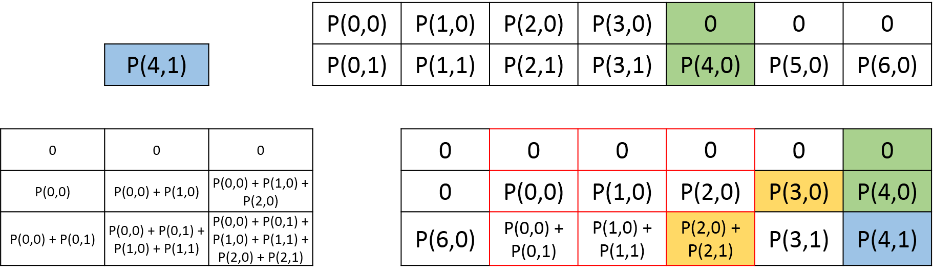

Slide 17
 |  |  | P(0,0) | P(1,0) | P(2,0) | P(3,0) | P(4,0) | 0 | 0
 | P(5,1) |  | P(0,1) | P(1,1) | P(2,1) | P(3,1) | P(4,1) | P(5,0) | P(6,0)
0 | 0 | 0 |  | 0 | 0 | 0 | 0 | 0 | 0
P(1,0) | P(1,0) + P(2,0) | P(1,0) + P(2,0) + P(3,0) |  | P(0,0) | P(1,0) | P(2,0) | P(3,0) | P(4,0) | P(5,0)
P(1,0) + P(1,1) | P(1,0) + P(1,1) + P(2,0) + P(2,1) | P(1,0) + P(1,1) + P(2,0) + P(2,1) + P(3,0) + P(3,1) |  | P(0,0) + P(0,1) | P(1,0) + P(1,1) | P(2,0) + P(2,1) | P(3,0) + P(3,1) | P(4,1) | P(5,1)

